Slide 1

The
Mysteries
of the
Mass
Explained
719-599-5031
2650 Parish View
Colorado Springs, CO 80919

Slide 2
PURPOSE
The purpose of this booklet is to help the faithful prepare to celebrate the “Sacred Mysteries” of the Mass. It aims to reveal, at least in part, the mysterious reality that lies beneath the sacramental signs that constitute the physical form of the Sacred Liturgy. Hopefully, it will inspire a more complete appreciation and deeper encounter with the spiritual and often imperceptible nature of the Mass that exists beneath its outward actions, prayers, and rituals.
Unlike other guides or missals, that prescribe the postures, gestures, and responses of the faithful during the Liturgy, this booklet is not intended for use during Mass. However, it can be useful in explaining the meaning behind liturgical actions that might otherwise appear confusing or unnecessary. Use of this booklet will hopefully promote, greater understanding of the “Mystery of the Mass” and will help the faithful reader participate more fully in the sacrament that is the “Source and Summit” of our Faith.

Slide 3
SOURCES
This booklet is the product of a year long study of the Mass (2025-26) by a group of St Francis parishioners who viewed and discussed the 52-session program “The Mass Explained” by Dr. Brant Pitre.
The pictures are from the public domain and were inspired by Dr. Pitre’s “Mystagogical” analysis of each Mass segment.
The photos of the Mass were extracted from livestream recordings posted for public use on the St Francis of Assisi Parish website.
The commentary is based on excerpts and interpretations of material from the Study Guide and Lecture Transcripts from Dr . Brant Pitre’s “The Mass Explained” Series produced by Catholic Productions.
https://catholicproductions.com/blogs/the-mass-explained
Reproduction of this booklet is freely permitted for use as a catechetical tool in parishes, but not for sale except to cover the cost of copying.
January 2026

Slide 4
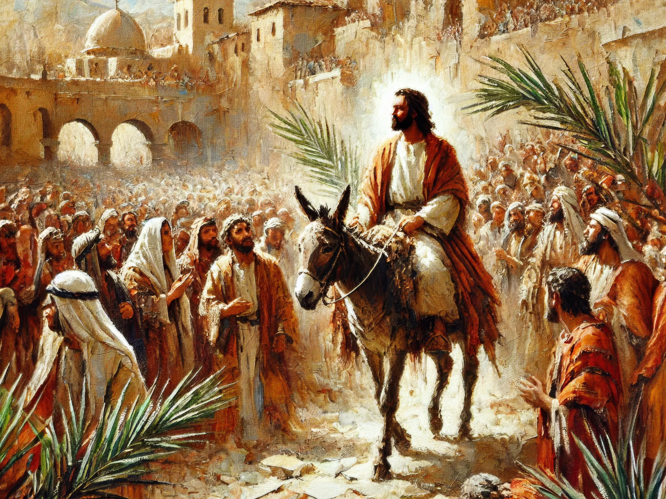
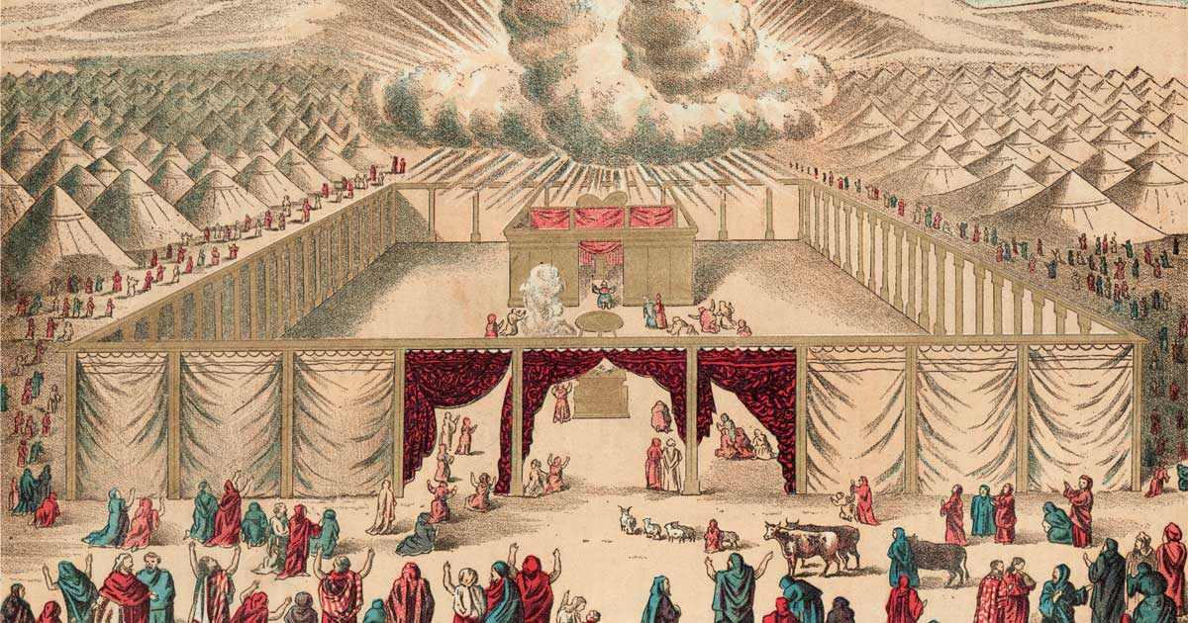
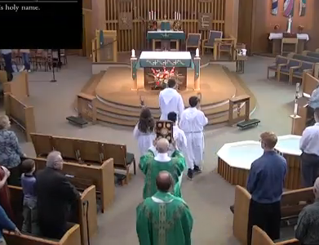
Introductory Rites (We gather as God’s people before His throne in heaven)
Entrance Procession
  The assembly that God called together rises and begins to sing. Many voices make one beautiful sound; the voice of the Church echoes the hymn sung eternally in the halls of heaven. We enter into the Heavenly Liturgy.
  The ministers and the priest follow the cross, dressed in different robes signifying different roles. Some carry flames, some incense, the deacon carries the Book of Gospels to the altar of sacrifice.
  The priest culminates the procession making visible and concrete what earthly eyes cannot see, namely Christ himself coming into the midst of His people to lead them in prayer.
Jesus enters Jerusalem
on Palm Sunday
- Luke 19:28-40
The people stood as Moses Enters
Tabernacle to Meet YHWH
- Ex 33:9-11
Entrance Procession
INTRODUCTORY RITES
1

Slide 5
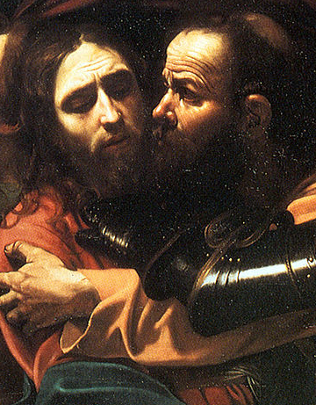
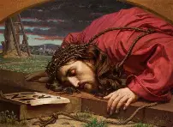
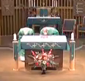
Introductory Rites (We gather as God’s people before His throne in heaven)
Entrance Procession – Kissing the Altar
  The priest and the deacon kiss the altar which represents the victim as well as the place of sacrifice.
  The priest reverences the altar:
  As the vessel that brings us our crucified Lord.
  As Christ Himself, who is the “stone rejected by the builders that becomes the cornerstone.” –Matthew 21:42
  As a symbol of reverence to martyrs for the faith. A relic of a saint (martyr?) is often contained in the altar (or in a stone) near its front edge.
  As a sign of his own unworthiness.
  As a reminder to lay down his own life for his flock, like his Good Master.
“Judas, do you betray me
with a kiss”
- Luke 22:48
Kiss (of betrothal)
“No greater Love…”
-Jn 15:13
Kiss of Altar
INTRODUCTORY RITES
2

Slide 6
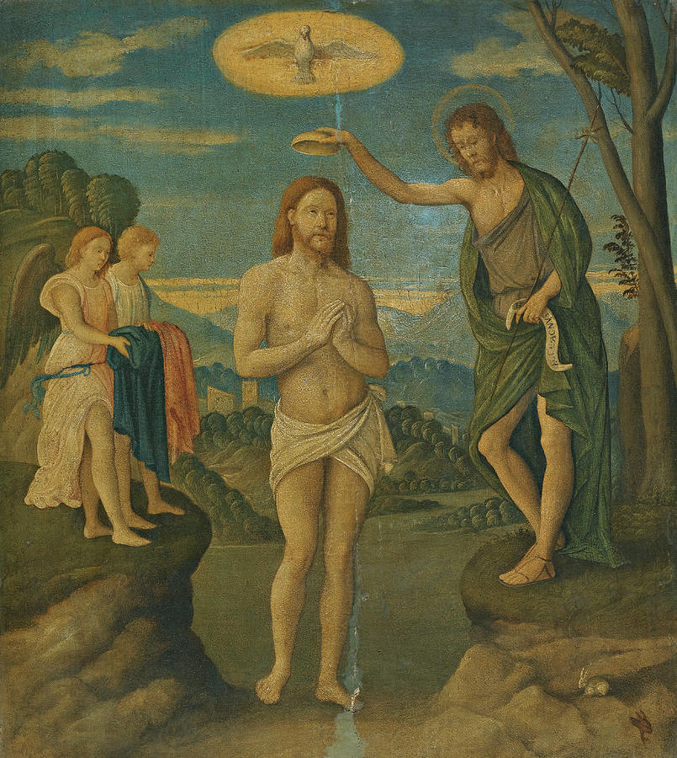
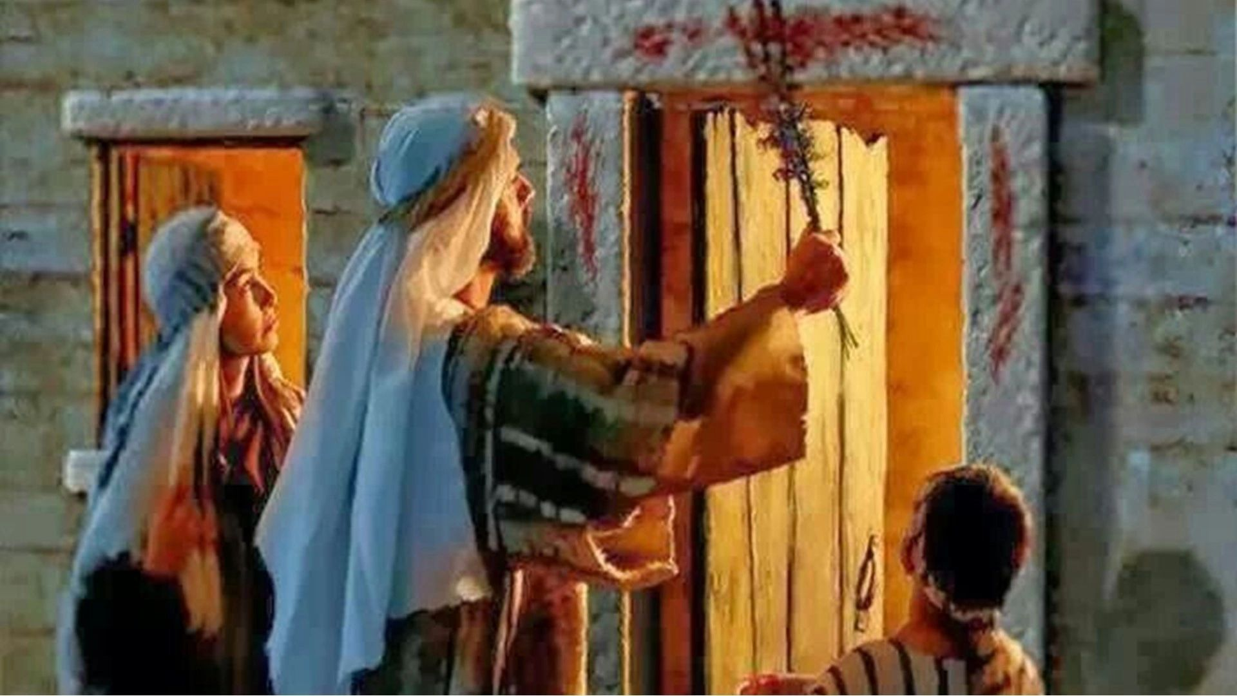
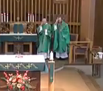
Introductory Rites (We gather as God’s people before His throne in heaven)
Sign of the Cross
  The priest and people make the Sign of the Cross recalling that Baptism is the door to the mystery they are about to experience. All say “Amen!”...meaning I accept my Baptism again and I believe in the holy name of God.
  The priest (representing Christ, the head) leads the body in prayer saying: “The Lord be with you,” asking if they are ready to participate in the sacred action their Baptism admits them to.
  The people say: “And with your spirit,” indicating their readiness to follow where he is ordained to lead them.
We remember Jesus’ baptism and our own.
- Mark 1:9-11
Jews mark  their doors before first Passover.
- Exodus 12: 13-28
Sign of the Cross
INTRODUCTORY RITES
3

Slide 7
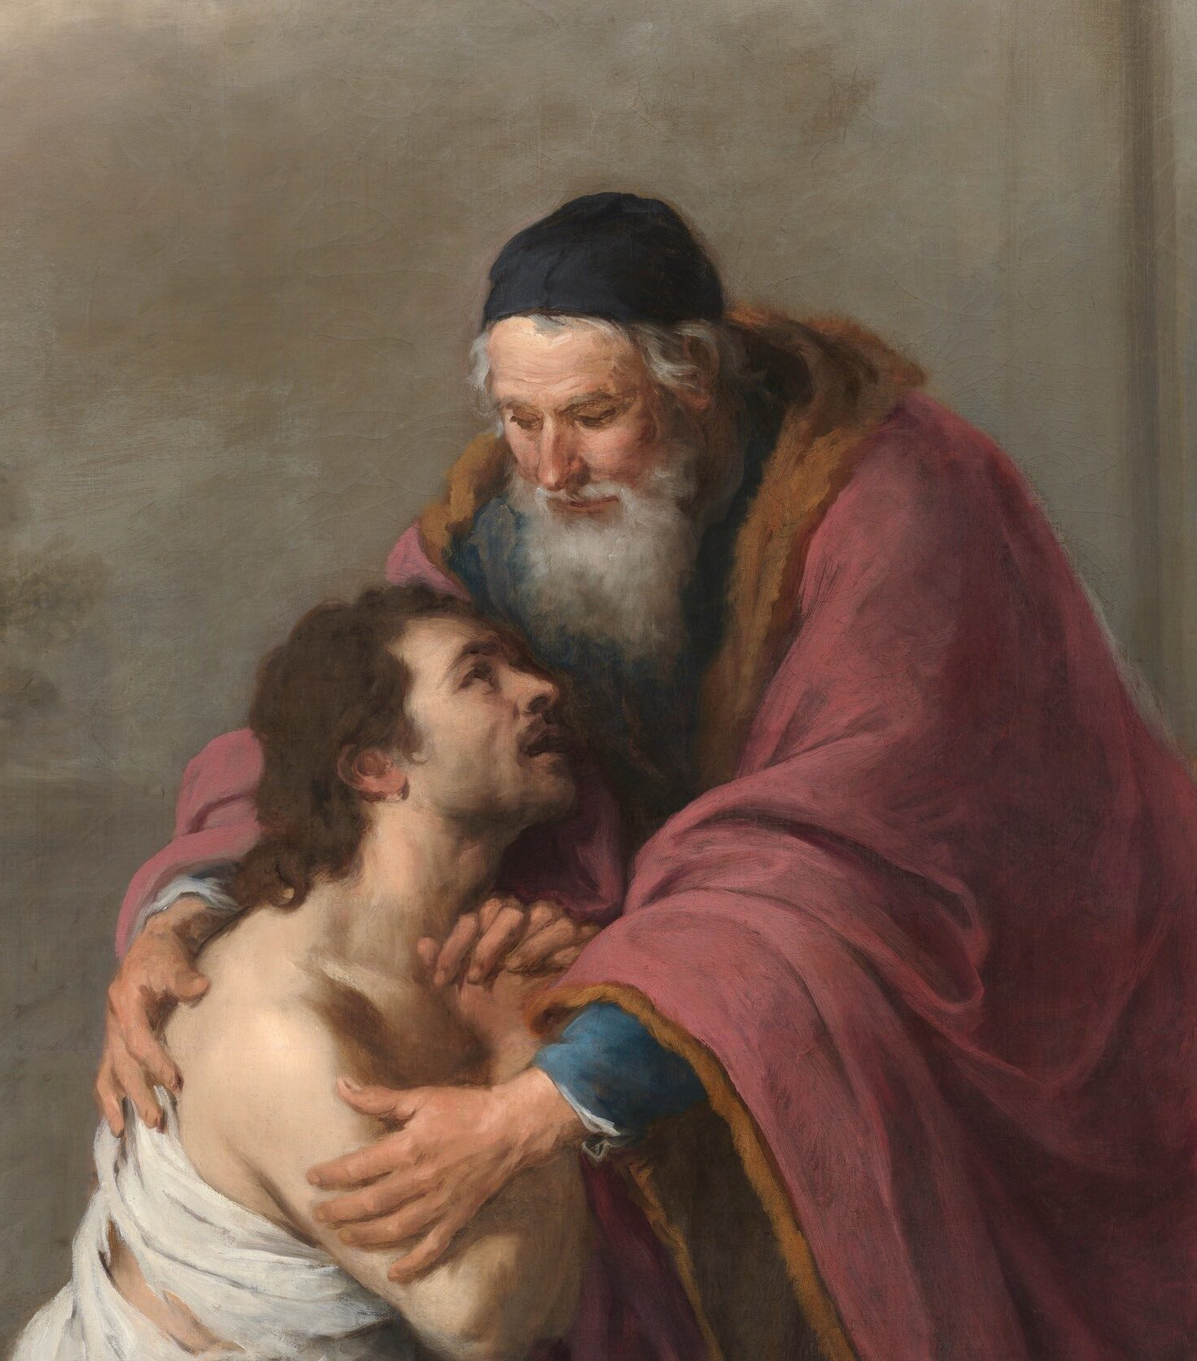
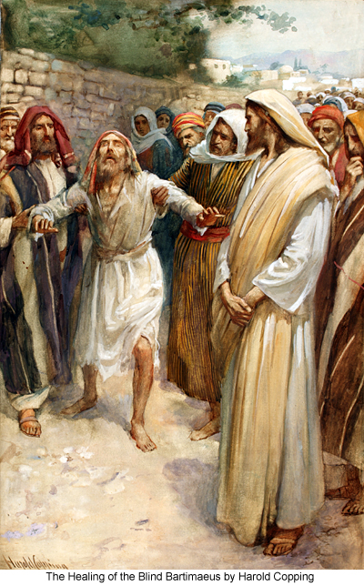
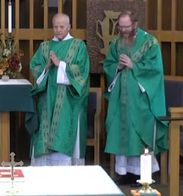
Introductory Rites (We gather as God’s people before His throne in heaven)
Silence
“Father, I have sinned…”
- Luke 15: 21
The Penitential Act - Confiteor
  The priest and people confess their sins to God and each other and, with the saints’ intercession, ask God, in His mercy, to purify and prepare them to celebrate the sacred mysteries that follow.
  There are several forms of this rite. In one, we pray the “Confiteor” together asking Mary, all the angels & saints, and one another to “pray for me to the Lord our God.”
  It reminds us that we are united in the liturgy with the entire Body of Christ.
“…that we might celebrate the sacred mysteries.”
“Lord, that I might see.”
- Luke 18:41
I Confess
INTRODUCTORY RITES
4

Slide 8
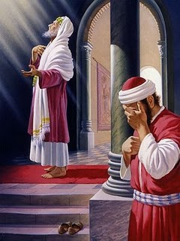

Introductory Rites (We gather as God’s people before His throne in heaven)
Kyrie Eleison – Lord Have Mercy
  The priest and people strike their breasts, acknowledge their faults, and beg the Lord for mercy and forgiveness of their sins.
  Our act of contrition is an act of humility before our Creator and His Church.
  With the proper disposition, this act can remove venial sins in preparation for receiving Holy Communion. However, mortal sins are not removed and must be confessed and absolved in the Sacrament of Reconciliation before receiving Holy Communion.
Mea Culpa, Mea Culpa, Mea Maxima Culpa
“Lord Have Mercy on me a sinner”
- Lk 18:13
Lord, Have Mercy
INTRODUCTORY RITES
5

Slide 9
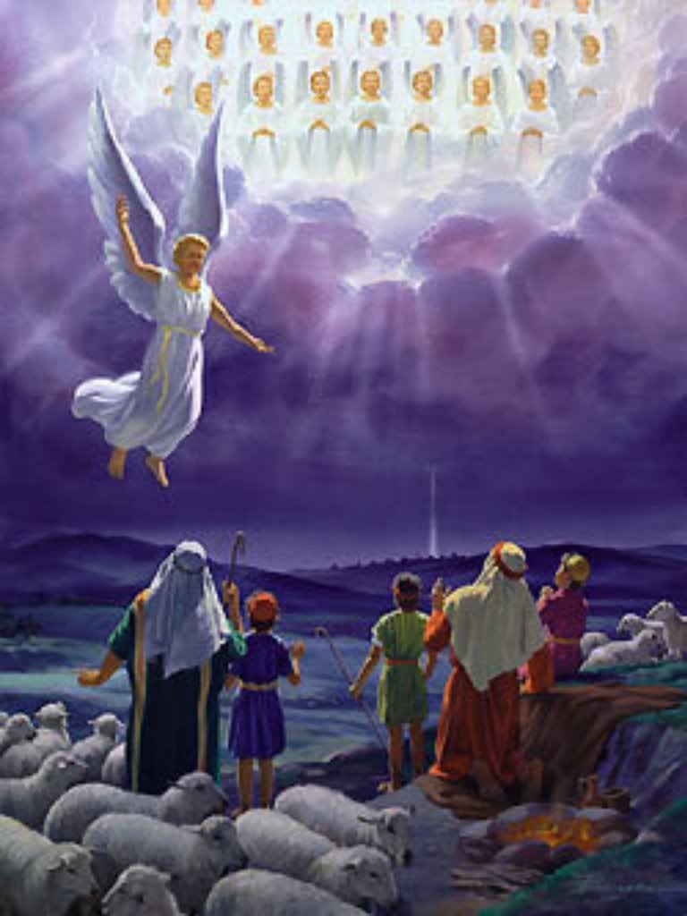
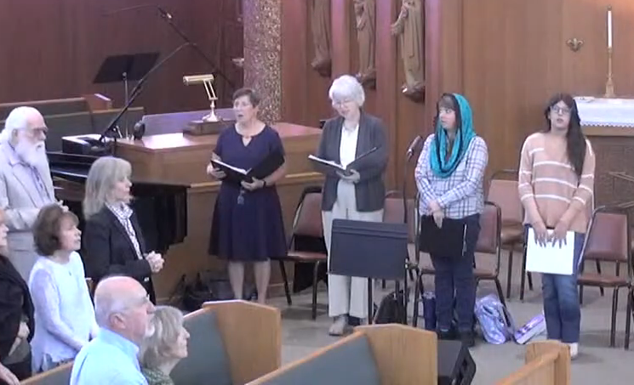
Introductory Rites (We gather as God’s people before His throne in heaven)
Gloria
  We sing the Gloria…an explosive hymn of joy, praise, and anticipation.
  We sing together with the angels for the same reason they first sang; to glorify God who sent His Son among us, born of the same flesh.
  As we stand together singing our praise, we anticipate God’s speaking to us in the Liturgy of the Word which is about to begin.
  In Advent and Lent we abstain from singing this hymn so it can ring out with fresh vigor on the feasts for which these seasons prepare us.
“Glory to God in the Highest”
- Luke 2:14
Gloria
INTRODUCTORY RITES
6

Slide 10
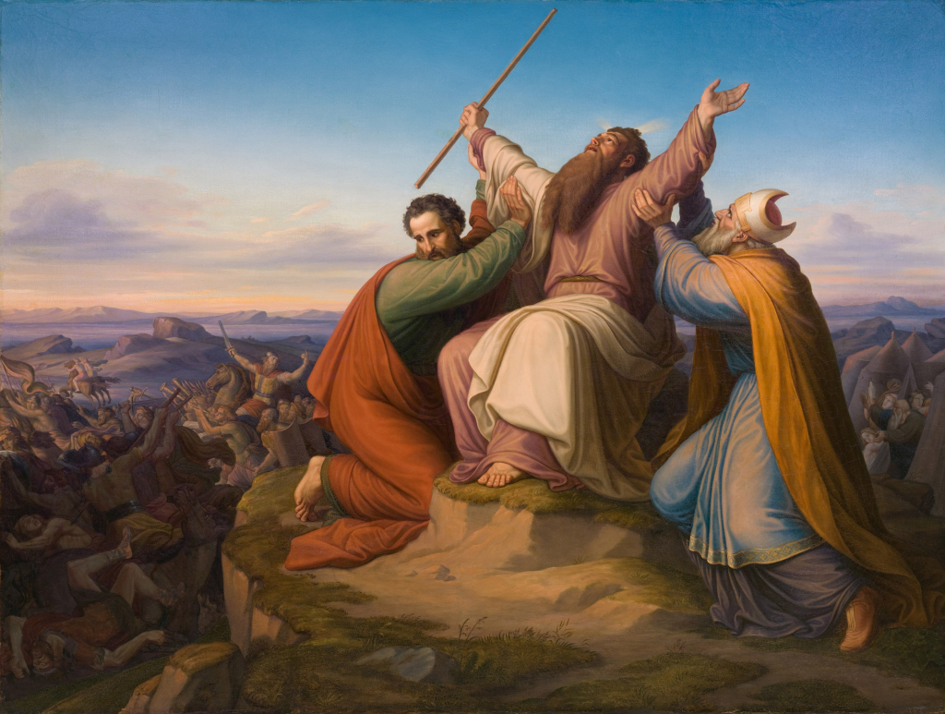
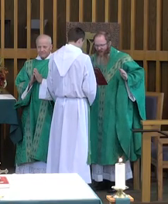
Introductory Rites (We gather as God’s people before His throne in heaven)
Collect
  The priest invites the people, “Let us pray.”
  After a short pause, the priest extends his hands praying to God the Father, recalling what He has done in the past, and asking Him to grant what we (His children) need in the present.
  The priest “collects” the many strands of individual thought and silent petition coming from the assembly and incorporates them into one succinctly expressed prayer to the Father.
  The Collect prayer closes with the form that marks all the praying of the Mass which is addressed to the Father, through the Son, and in the Holy Spirit.
Arms uplifted, Moses prays to God on behalf of the people.
- Exodus 17:12-14
The Collect
INTRODUCTORY RITES
7

Slide 11
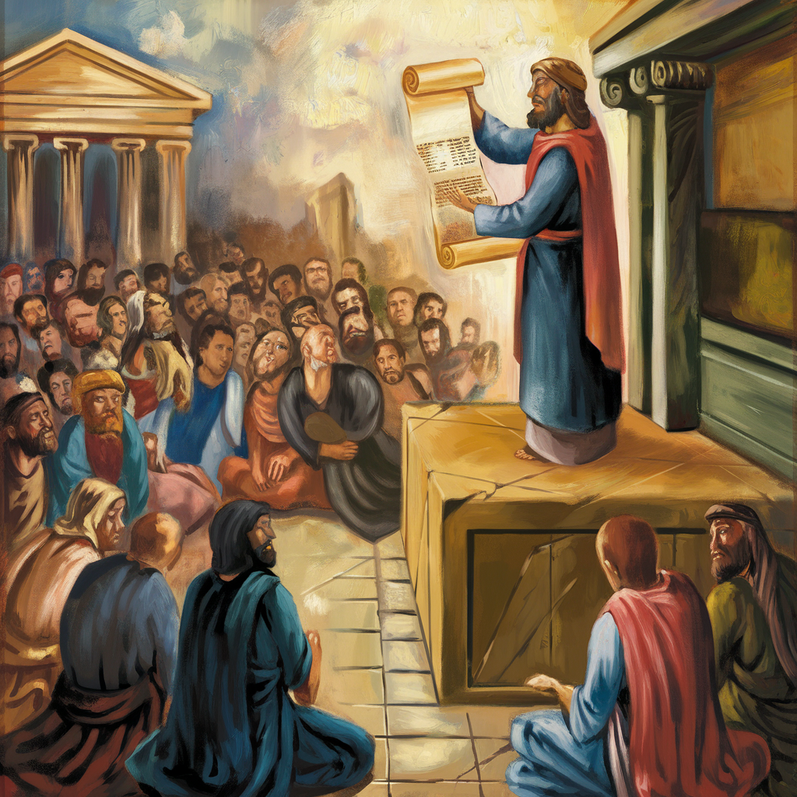
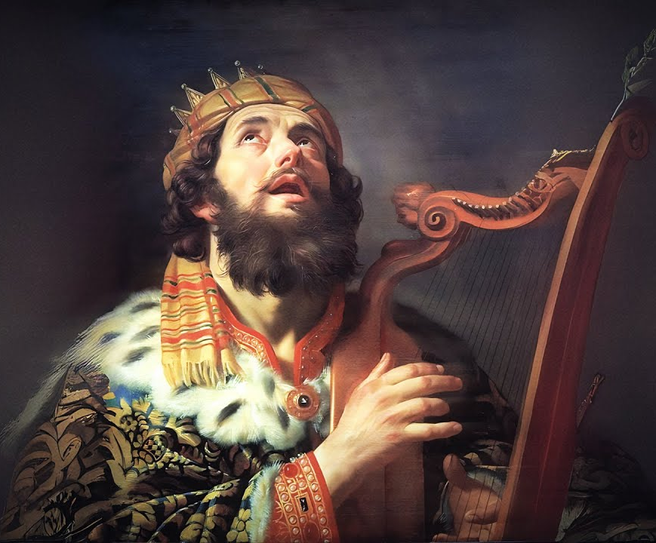
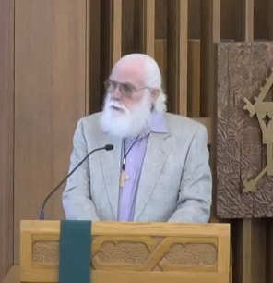
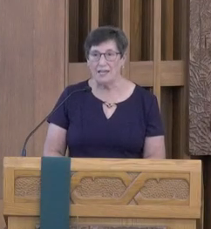
Liturgy of the Word (God speaks to us and we, the Church, respond)
1st Reading
  Usually taken from the Old Testament (OT) or the Book of Acts, this reading relates events and prophesies that point toward the central paschal mystery of Jesus’ life, death, and resurrection which the Mass celebrates.
  The assembly hears the scriptures in the presence of the Resurrected Jesus, like the disciples at Emmaus whose hearts burned as the OT scriptures opened their treasures to the key of the Risen Christ.
  In gratitude, the assembly responds: “Thanks be to God.”
Responsorial Psalm
  In the Responsorial Psalm we respond to Him. Christ is in God’s Word to us, in our assembly who receives it, and in our response.
  Christ borrows the voice and talent of a cantor, one of His own members, and uses it as His voice of prayer. Jesus’ life fulfilled the Psalms and He prayed them during His life.
  The assembly responds and with its voice joins Jesus’ praise, thanksgiving, lament or petition to the Father.
  The Responsorial Psalm forms a bridge between the prophesies and events in the 1st Reading and their fulfillment in the Gospel.
1st Reading from Old Testament or Acts.
Ezra reads the Torah to the people.
- Nehemiah 8:3-6
A cantor sings from Book of Psalms.
David praises the Lord in song.
- 2 Samuel 22
1st Reading
Responsorial Psalm
LITURGY OF THE WORD
8

Slide 12
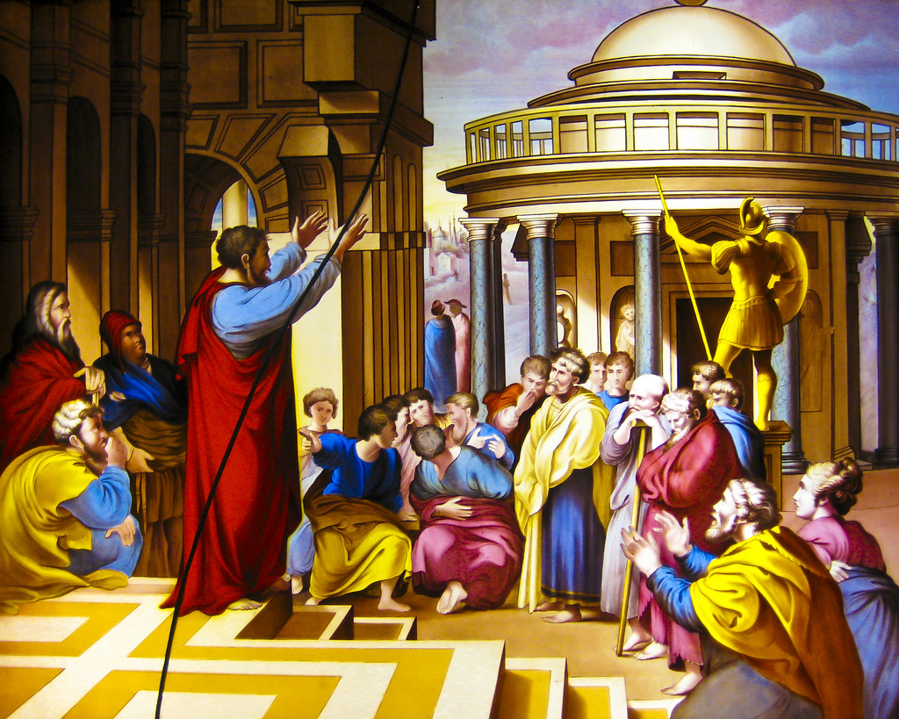
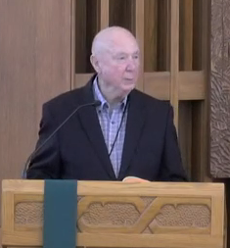
Liturgy of the Word (God speaks to us and we, the Church, respond)
2nd Reading
The 2nd Reading is always taken from one of the letters of the Apostles. They provide penetrating reflections on the Apostles’ experiences of the Life, Death, and Resurrection of Jesus. We encounter the Risen Lord through their witness.
They show, in various ways, that believers are called to share in the Lord’s suffering and so in His victory. Through the words of His Apostles, Jesus Christ himself sinks down into the hearts and minds of His people.
At the end of the reading, the assembly responds: “Thanks be to God” in gratitude for the teaching passed down through His chosen Apostles.
2nd Reading; from Epistles or Paul/Apostles
Paul preaches to Gentiles in Athens.
- Acta 17:22-23
2nd Reading
LITURGY OF THE WORD
9

Slide 13
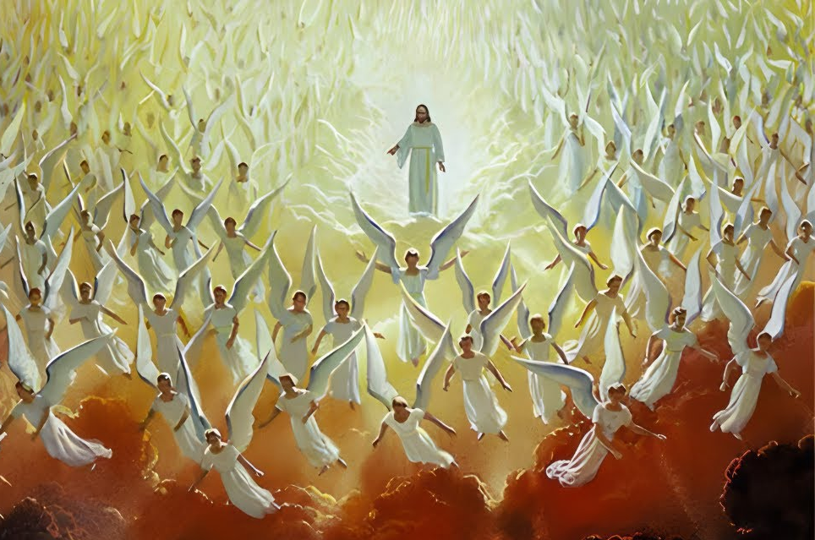
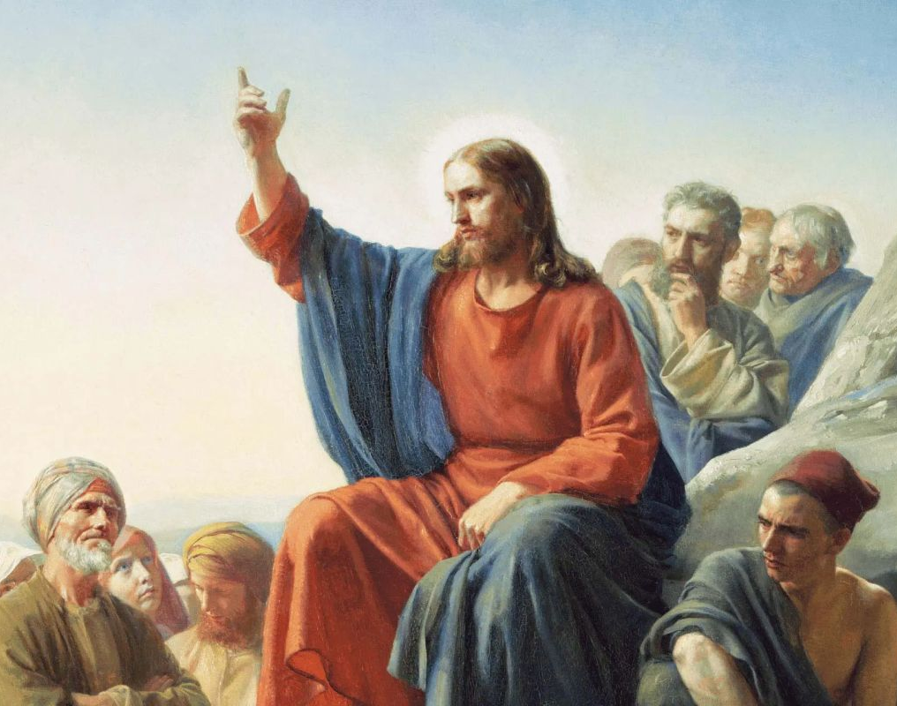
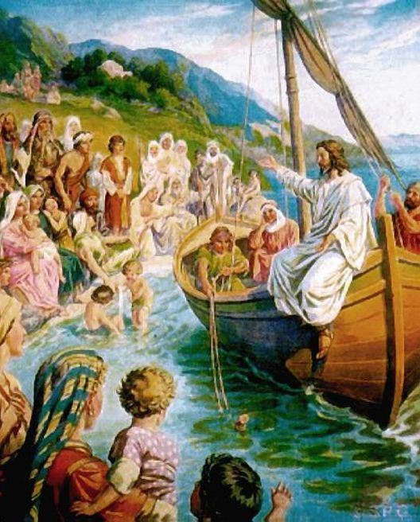
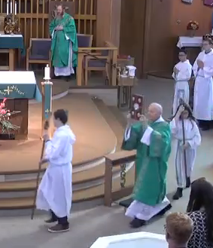
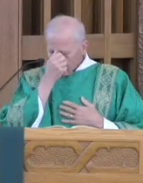
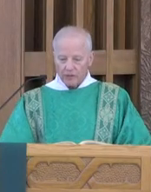
Liturgy of the Word (God speaks to us and we, the Church, respond)
Gospel
  We rise to our feet singing “Alleluia” shouting praise for the Lord’s Resurrection. The Risen One is present in the Words contained in the book carried by the deacon before the assembly who reverence it with a bow.
  The deacon says: “The Lord be with you”, makes a Sign of the Cross with his thumb over the text of the Gospel to signify where the blessing comes from; then a Sign of the Cross over the forehead, lips, and heart praying that intellect & speech be blessed and heart opened.
  When we hear Jesus speak and see Him act, we should be mindful that He is the Father’s Word given to us. What Jesus says and does reveals the Father. The Word reaches its mark in our hearts because it comes accompanied by the Holy Spirit, just as Christ first came into the world accompanied by the Spirit.
  The Gospel is the center of the Liturgy of the Word and is always read by a deacon or a priest (or by the bishop if neither is present). This alerts the assembly to the fact that Christ himself, the one who was crucified and risen, is now speaking to His assembled Church.
“I heard a great voice in heaven
saying: Alleluia!” - Rev 19:1-4
“Seeing the crowds, he went up…and
taught them…
and they were astonished”
- Matthew 5-7
Gospel
“He sat down…and taught the people
from the boat” - Luke 5:2-3
LITURGY OF THE WORD
10

Slide 14
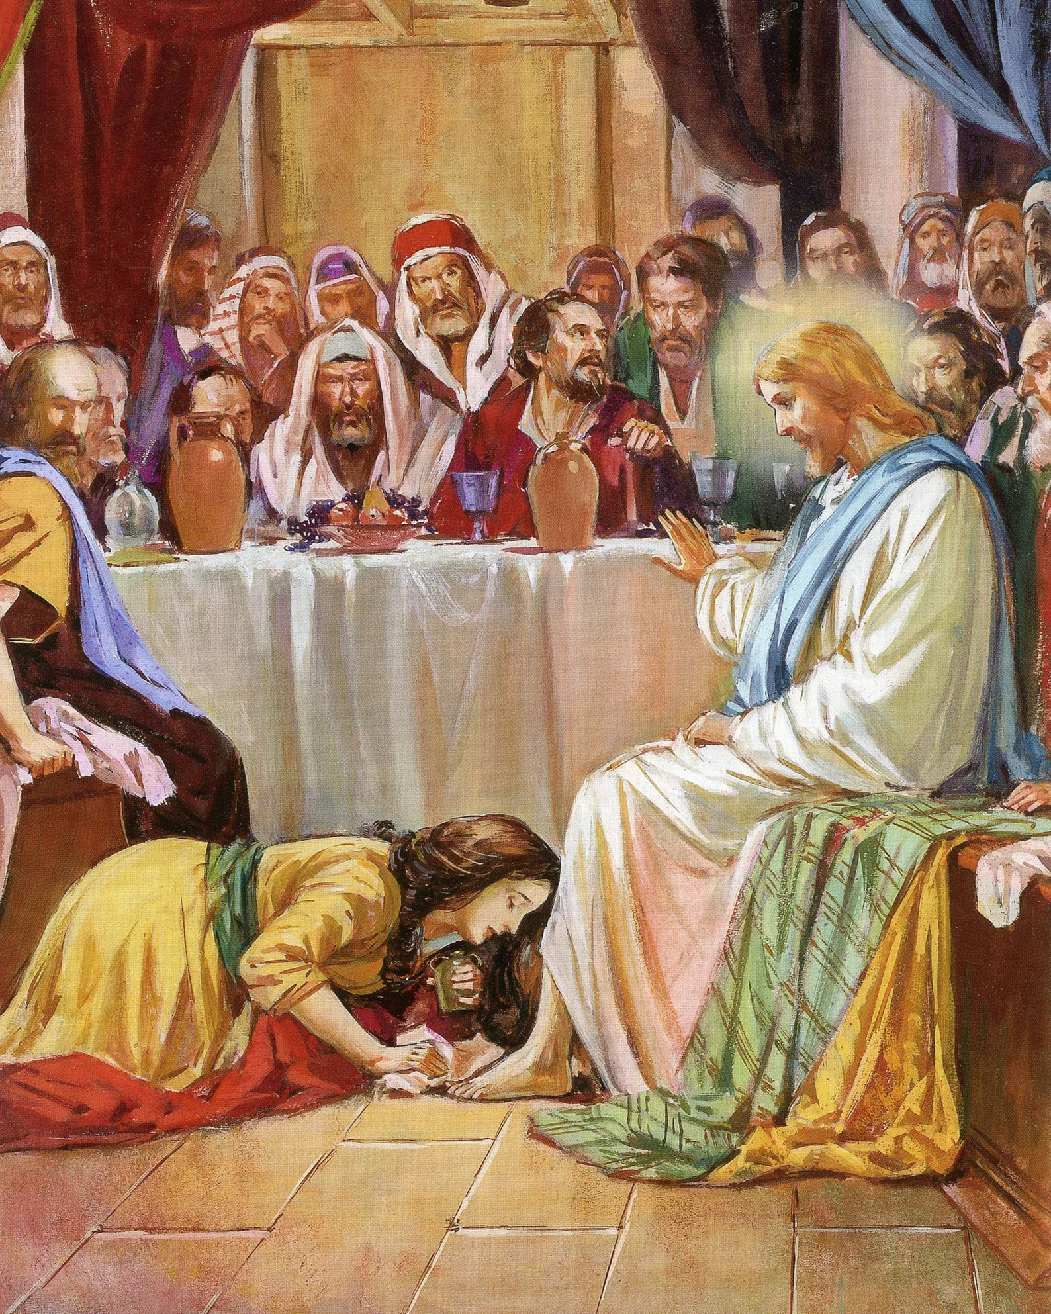
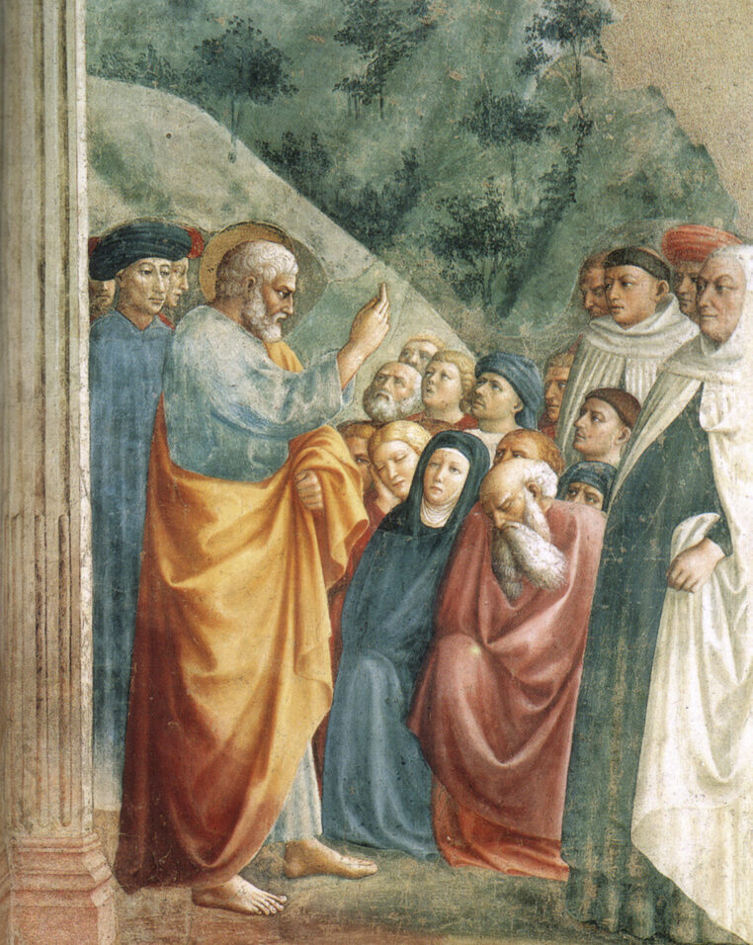
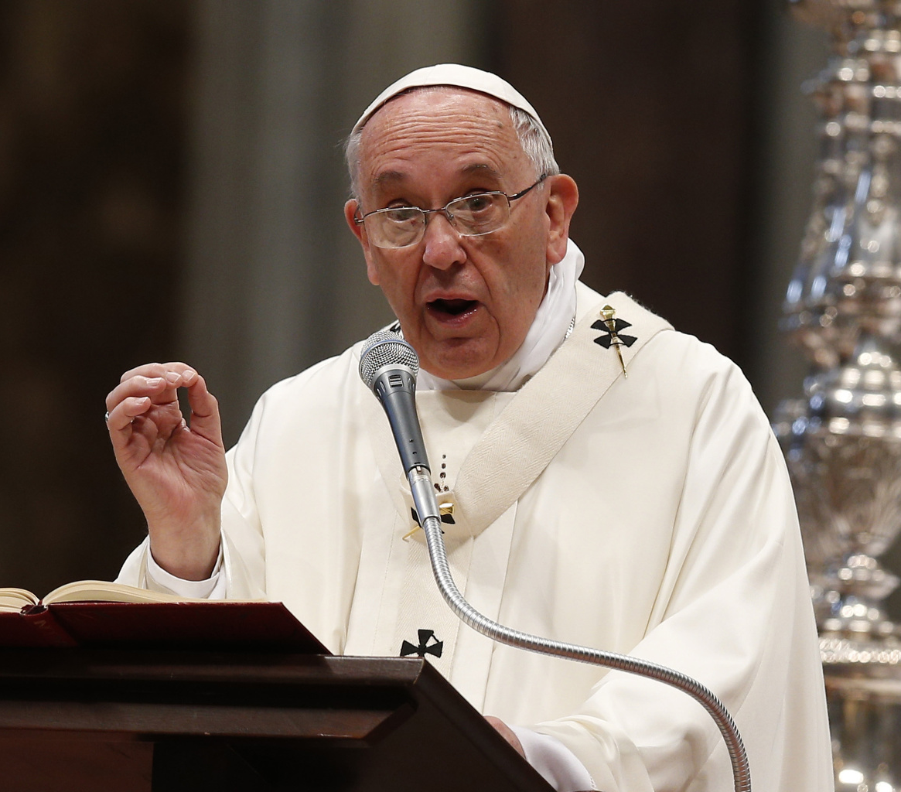
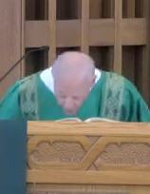
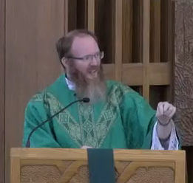
Liturgy of the Word (God speaks to us and we, the Church, respond)
Gospel (concluded)
When the Gospel is finished the deacon or priest says: “The Gospel of the Lord.” The people respond: “Praise to you Lord, Jesus Christ.”
The deacon kisses the Gospel text and prays: “Through the words of the Gospel may our sins be wiped away.”
This prayer indicates that the Gospel may be understood as a “sacramental” effecting the remission of venial sins.
Homily
The word “homily” means “explanation” in Greek. The homilist draws out the meaning of the Scripture passages just read and then reflects on how they apply to the current situation in which the faithful find themselves.
The homily also explains the link between the Liturgy of the Word, which precedes it, and the Liturgy of the Eucharist, which is about to begin.
The homily is given by a deacon, priest, or bishop and is required for every Sunday and Holy Day of Obligation but is encouraged at all Masses.
Kissing the Word of God
“may our sins be wiped away”
- Luke 7:38
Peter lifted up his voice…and [explaining the Gospel] exhorted them. - Acts 14-40
Gospel
Homily
LITURGY OF THE WORD
11

Slide 15
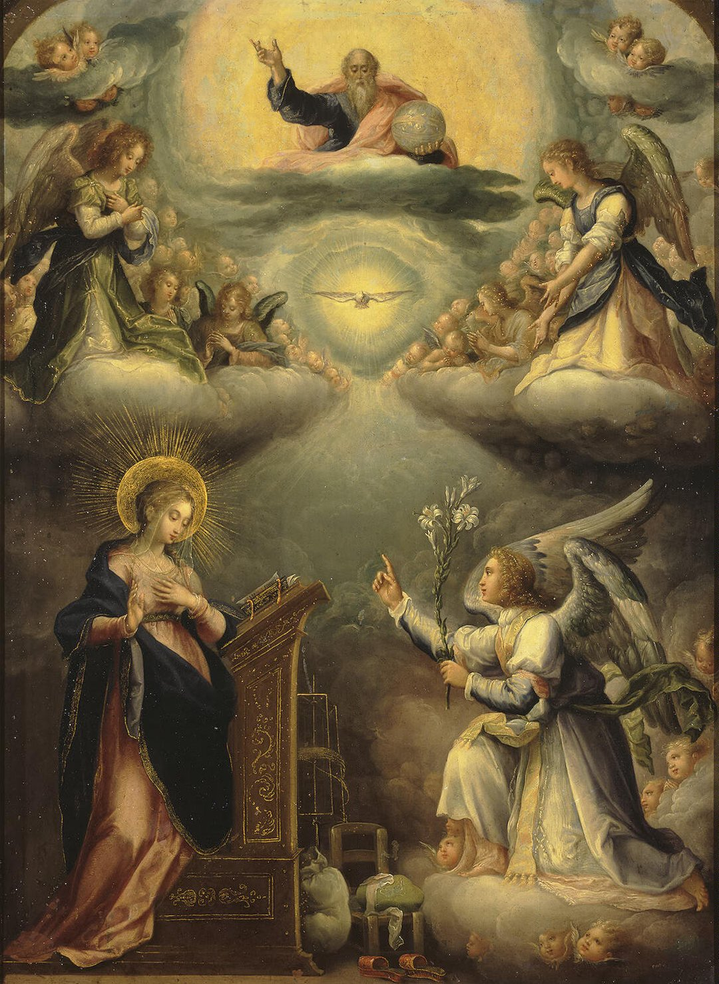
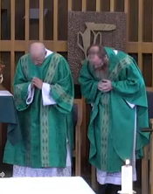
Liturgy of the Word (God speaks to us and we, the Church, respond)
Silence
The Creed
  After the homily and a period of silence, the Creed or Profession of Faith is said on Sundays and Solemnities. The Nicene Creed is usually used, but in certain circumstances the Apostles Creed may be used.
  The Creeds have their origin in Baptism and are important reminders that it is only through Baptism that we can enter into the Liturgy of the Eucharist which is about to begin.
As the Liturgy of the Word concludes, the assembly stands and with one voice declares all that the apostolic Church believes in its careful listening to the Word of God. Every baptized person confirms again his or her belonging to the community that believes these things.
CREDO: “I believe in one God…
The Father…Son…and Holy Spirit”
The Creed
LITURGY OF THE WORD
12

Slide 16
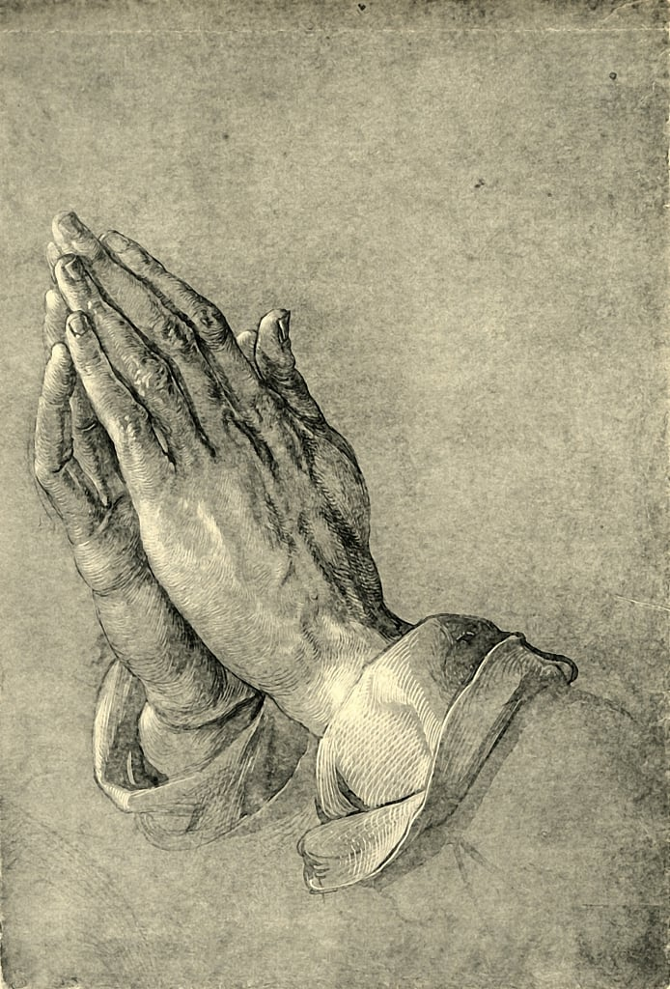
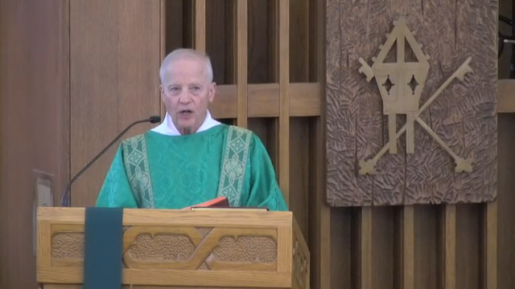
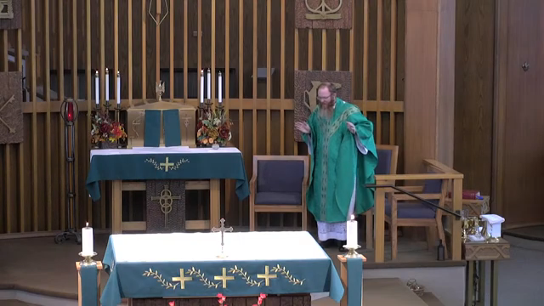
Liturgy of the Word (God speaks to us and we, the Church, respond)
Prayers of the Faithful
  The priest, as a living sacrament of Christ at the head of His body, invites the people to pray. Then a deacon, or some other person, articulates particular petitions on behalf of the assembly.
  The assembly responds with its combined voice to each petition bringing before God the needs of the Church and the whole world.
  The movement of the prayer is toward God the Father through Christ in the person of the priest. This is a sharing of his priestly role of interceding for the world; each member of the assembly exercises their Common Priesthood received in Baptism.
  The Prayers of the Faithful are a bridge between the Liturgy of the Word and Liturgy of the Eucharist. All that we pray for will be brought forward with the bread and wine and placed in Christ’s hands for transformation.
For these petitions we pray…
“Lord, Hear our Prayer”
- Psalm 143:1, Psalm 102:1
Prayers of Faithful
LITURGY OF THE WORD
13

Slide 17
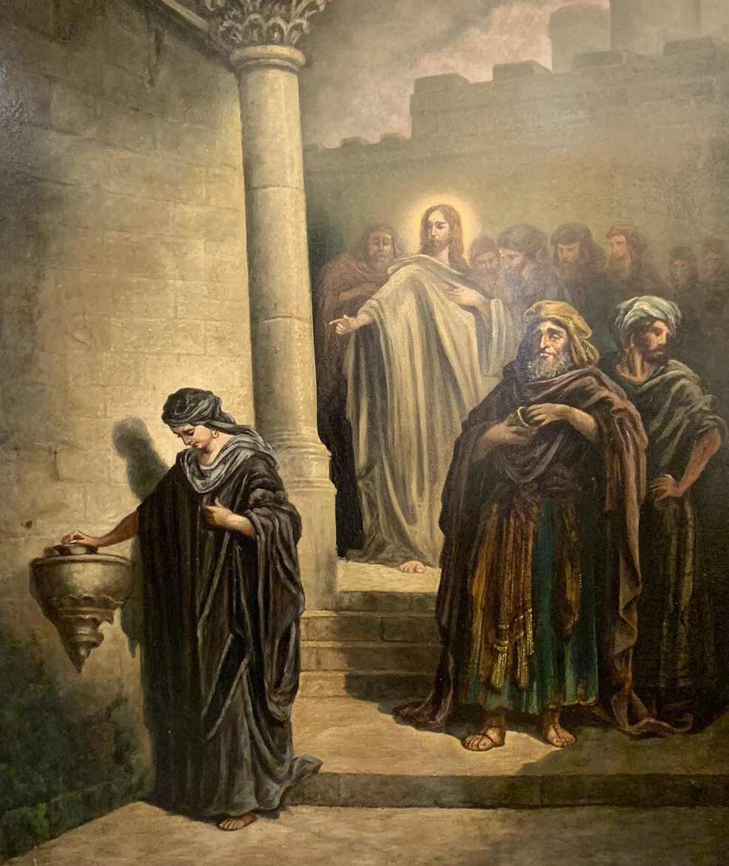
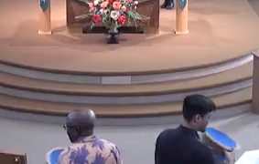
Liturgy of the Eucharist (Through the Holy Spirit, Christ offers His sacrifice & ours to the Father)
The Collection
  As bread and wine are prepared to be brought forward for the Eucharistic sacrifice, some among the assembly begin to collect gifts of money. The money is not merely something practical; it represents our work, our time, our personal sacrifice of returning God’s gifts.
  St Paul urged us “to offer your bodies as a living sacrifice, holy and pleasing to God” (Rom 12:1). The collection represents this offering done “through, with and in” Christ’s offering enacted in what follows.
  The people should reflect on what aspects of their lives they might offer: efforts, failures, trials, anxieties, desires, joys. These spiritual offerings are presented along with material ones in the hope that they will be transformed. The action is saying to Christ: “Do something with this. Make our lives be what Your life was and is.”
“The poor widow…out of her poverty…put in all she had,
her entire life.” - Mk 12:41f, Lk 21:1f
The Collection
LITURGY OF THE EUCHARIST
14

Slide 18
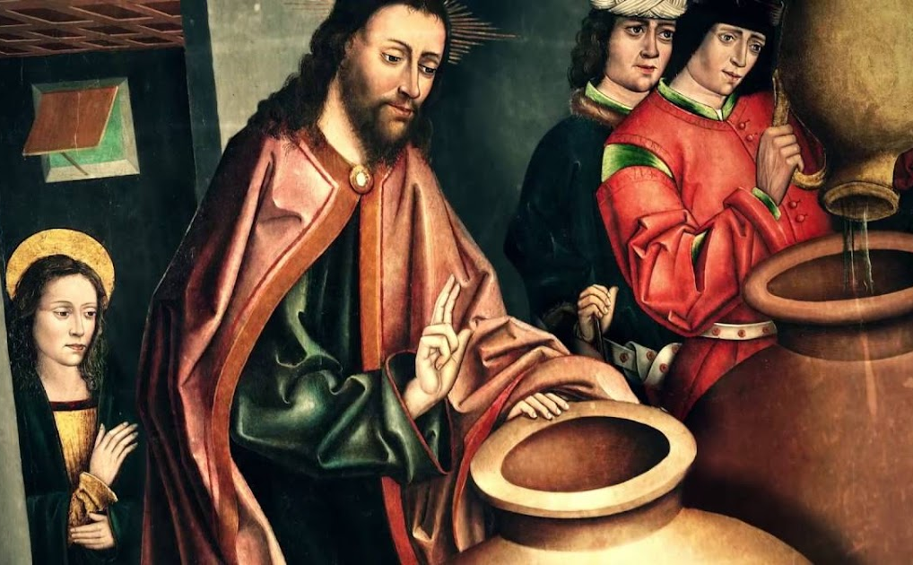
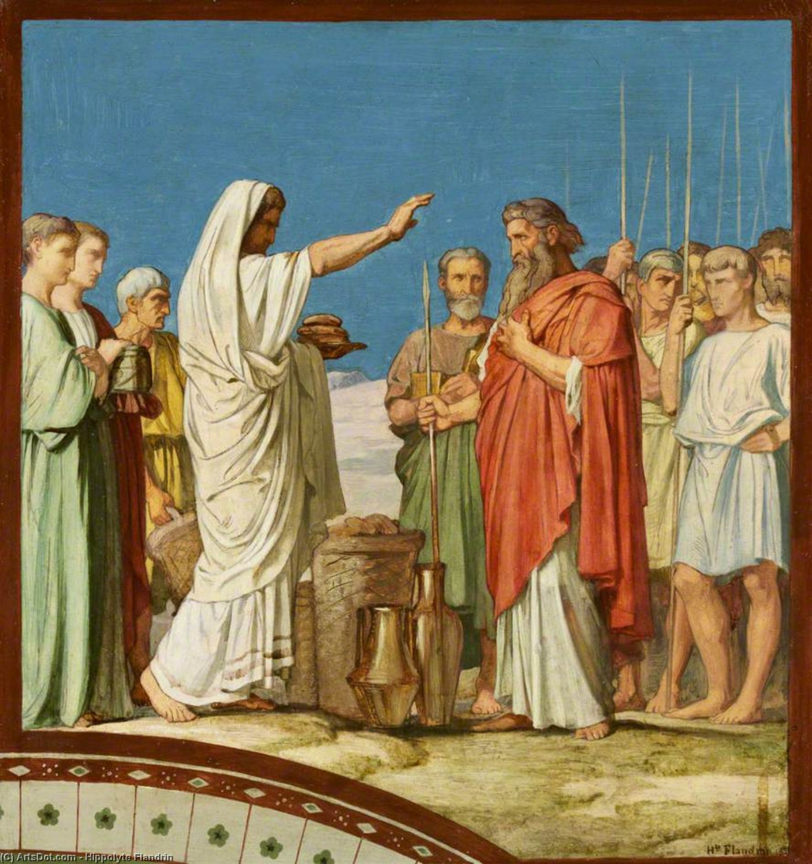

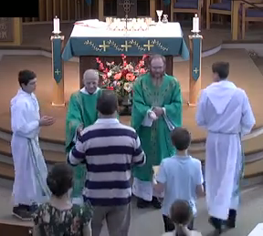
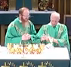
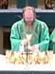
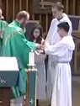
Liturgy of the Eucharist (Through the Holy Spirit, Christ offers His sacrifice & ours to the Father)
The Offertory
  Gifts of bread and wine are brought to the altar…products of the cooperation between the Creator and human beings and representing our cooperation with Jesus’ sacrifice about to occur. This is an exercise of the Common Priesthood of the faithful.
  A magnificent exchange begins to take place. We bring our lives, efforts, failures, trials, anxieties, joys and we place them in the hands of Christ (the priest), who joins them to his own offering.
  After the procession, the bread and wine are brought to the altar, and the priest blesses God in thanksgiving and anticipation of their transformation into “the bread of life” and “our spiritual drink.”
  The priest or deacon mixes a drop of water into the wine with an inaudible prayer that calls to mind the mystery. The water placed in the wine represents our poor humanity, which will be completely joined to Christ’s divinity.
  The priest washes his hands as a reminder that the level of action is about to shift and his hands now turn to a new purpose. His hands become Christ’s own hands that will take up the gifts, transform them, and offer them to the Father.
“By the mystery of this
water & wine
may we share
in the Divinity of Christ”
- John 2:1-12
The people bring bread &
wine like Melchizedek.
- Genesis 14:18f
The priest prays silently
as he washed his hands
The Offertory
LITURGY OF THE EUCHARIST
15

Slide 19
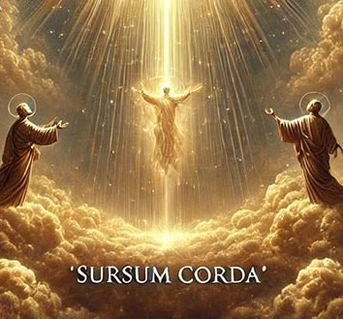
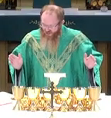
Liturgy of the Eucharist (Through the Holy Spirit, Christ offers His sacrifice & ours to the Father)
The Preface Dialogue and Preface
  The people stand and the priest urges: “Pray brothers and sisters, that my sacrifice and yours may be acceptable to God the almighty Father.” The people respond with “Amen” to all that has happened from the collecting of the gifts to this moment and in anticipation of the sacrifice that is about to begin. Standing, the people are poised for the biggest prayer of all.
  The priest summons the assembly in three short, intense exchanges:
    “The Lord be with you”; “And with your spirit.”
    The priest signals that both he and the assembly will need divine help for the intense prayer that follows. The people, addressing the “spirit” of the priest, ask that the Lord strengthen him in his role leading them in the sacred action.
    “Lift up your hearts”; “We lift them up to the Lord.”
    Through the priest, Christ tells his body that they are going right up to heaven where He is seated at the right hand of the Father. The people respond that their hearts are lifted to the heavenly place where we are meant to be for all eternity…where past and future become present.
    “Let us give thanks to the Lord our God”; “It is right and just.”
    The priest announces the purpose of our being present before the Lord, and the people assent. All that follows is a “thanksgiving” prayer, for that is what Eucharist means.
“Lift up your hearts!” - Lamentations 3:41
The Preface
LITURGY OF THE EUCHARIST
16

Slide 20
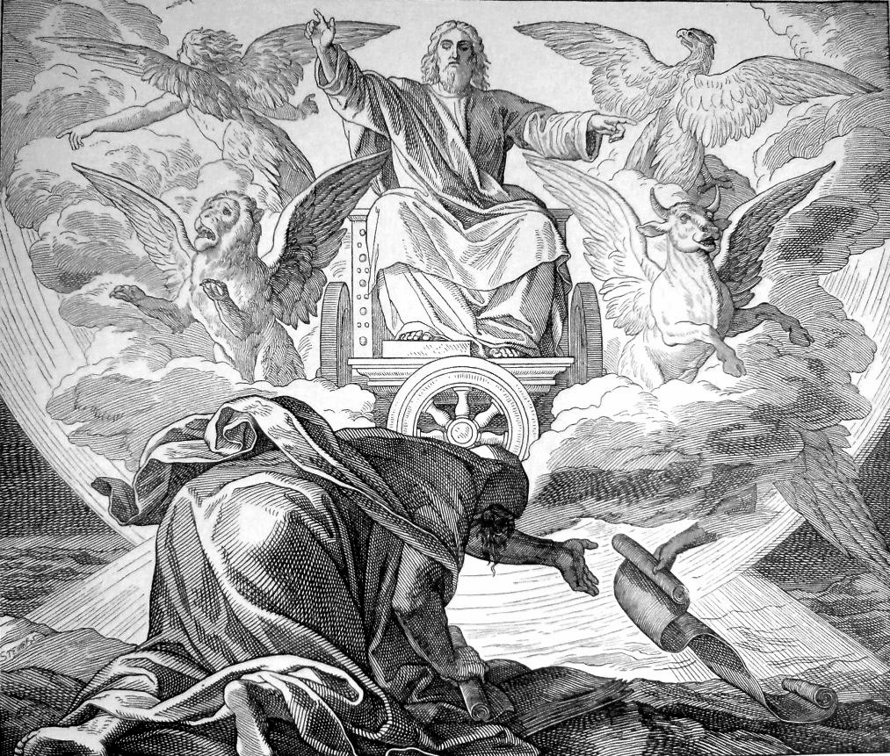

Liturgy of the Eucharist (Through the Holy Spirit, Christ offers His sacrifice & ours to the Father)
The Sanctus
  The people, standing before the throne of God, join the heavenly host in crying aloud: “Holy, Holy, Holy” recalling both John the Evangelist’s vision of the heavenly liturgy in the Book of Revelation (Rev 22:4) and Jesus’ entry into Jerusalem to begin His Paschal Mystery (Matt 21:9, Mk 11:10, Lk 19:38)
  At the end of the hymn, the people fall to their knees aware that they are actively participating in the prayers that follow.
  Now we enter into the eternal sacrifice that is forever present in Heaven. Christ the High Priest stands before the throne of God where the sacrifice of the Lamb is always present in the hour that never passes away.
“Four living creatures never ceased to say:
‘Holy, Holy, Holy’”
- Rev 4:8, Is 6:3
The Sanctus
LITURGY OF THE EUCHARIST
17

Slide 21




Liturgy of the Eucharist (Through the Holy Spirit, Christ offers His sacrifice & ours to the Father)
The Eucharistic Prayer – 1st Epiclesis
  The priest begins by recalling God’s blessing in creation and history and prepares us to offer our own sacrifice along with his (Christ’s).
  He calls down the Holy Spirit (epiclesis, Greek) upon the gifts on the altar “so that they may become for us the Body and Blood of our Lord Jesus Christ.”
  The priest’s hands are stretched out over the bread & wine, a visible gesture that makes present what is invisible: the coming of the Holy Spirit into them causing them to become the Body and Blood of Christ.
  The action parallels the work of the Holy Spirit in the incarnation of Christ and His work throughout the entire life of Jesus.
  There are four principal Eucharistic Prayers. Each has its unique way of unfolding the Eucharistic Mystery. All contain an “epiclesis,” the institution narrative, a form of the Mystery of Faith, and the “Great Amen.”
From Eucharistic Prayer II
“When the dew fell upon the camp in the night,
the manna fell with it.” - Numbers 11:9
From Eucharistic Prayer III
The Eucharistic Prayer-1st Epiclesis
LITURGY OF THE EUCHARIST
18

Slide 22





Liturgy of the Eucharist (Through the Holy Spirit, Christ offers His sacrifice & ours to the Father)
Silence
The Eucharistic Prayer – Institution Narrative
  Then the priest re-presents what Jesus did at the Last Supper. When he comes to what Jesus said, the priest switches from past tense to the present tense.
  Over the bread, the priest says Jesus’ own words: “Take this, All of you, and eat of it, for this is My Body, which will be given up for you.” He holds it up before God the Father and for all the people to see. His genuflection in adoration expresses the whole Church’s faith that Christ himself is really, physically present in the appearance of the bread.
  Similarly, over the chalice, the priest says: “This is the chalice of My Blood…poured out for you” and genuflects in adoration because the Holy Spirit has come, and with the saying of Jesus’ words, the wine is transformed. The priest (Jesus) uses sacrificial language when he says that His Body is “given up” and His Blood is “poured out.”
“This is My Body…given up
This is My Blood…poured out”
-Matt 26:26f, Mk 14:22f, Lk 22:19f
“Take this, all of you, and eat of it…”
_- Matt 26:26f, Mk 14:22f, 1Cor 11:23f
Eucharistic Prayer-Institution Narrative
LITURGY OF THE EUCHARIST
19

Slide 23


Liturgy of the Eucharist (Through the Holy Spirit, Christ offers His sacrifice & ours to the Father)
Eucharistic Prayer - The Mystery of Faith
  In exclamation of awe and wonder and looking upon the Body, Blood, Soul and Divinity of Jesus on the altar, the priest says: “The Mystery of Faith.” In response, the people profess their faith directly to Jesus, “We proclaim Your death O Lord (past), and profess Your resurrection (present), until You come again (future).”
  The “anamnesis” (“re-presentation” or “memorial”) of Christ’s Paschal Mystery unfolds throughout the Eucharistic Prayer but is most explicitly proclaimed in the The Mystery of Faith prayer. Anamnesis is no weak remembering of a past event; it is an event itself, the event remembered…made present.
The Mystery of Faith
“Christ has died, Christ has risen, Christ will come again”
The Eucharistic Prayer-Mystery of Faith
LITURGY OF THE EUCHARIST
20

Slide 24


Liturgy of the Eucharist (Through the Holy Spirit, Christ offers His sacrifice & ours to the Father)
The Eucharistic Prayer – 2nd Epiclesis
  The Eucharistic rite does not stop at the sacrifice but envisions that we will consume. Christ’s Body and Blood. The priest calls upon the Holy Spirit (a second epiclesis) to “grant that…we may become one body, one spirit in Christ”
  Through our reception of His Body and Blood we pray that our transformation in Christ, through the Holy Spirit, will unite us with the Church throughout the world and throughout the centuries.
  The priest continues with intercessions that pertain to various members of the Body of Christ beyond the immediate assembly including saints in heaven, the faithful on earth, and the holy souls of the dead. All those become present to us as we offer our sacrifice in Christ, through the Holy Spirit, to the Father.
“How I long to gather you together as a hen
gathers her brood under her wings.”
- Matthew 23:37
“Grant that we, filled with the Holy Spirit,
may become one body, one spirit in Christ.”
- Eucharistic Prayer III
“We pray that with the Blessed Virgin Mary…
we may merit to be coheirs to Eternal Life.”
- Eucharistic Prayer II
The Eucharistic Prayer-2nd Epiclesis
LITURGY OF THE EUCHARIST
21

Slide 25


Liturgy of the Eucharist (Through the Holy Spirit, Christ offers His sacrifice & ours to the Father)
The Great Amen (Doxology)
  The priest and deacon (if present) elevate the Body and Blood of Christ and glorify God the Father saying: “Through Him, with Him, and in Him, O God almighty Father, in the unity of the Holy Spirit, all glory and honor is Yours, forever and ever.” The Church offers His one Body, to which we have been joined, to the Father for the glory of His Name and the salvation of the world. This is our communion with Christ’s sacrifice…Perfect Praise.
  The assembly cries out with a resounding AMEN! The Amen agrees to all that has preceded: the articles of the Creed, the Father, Son, and Holy Spirit believed in the Church, and the great mystery of God’s salvific plan being worked out with us in Christ through the Spirit.
“Through Him, with Him, In Him…O God almighty Father,
all glory and honor is Yours, forever and ever! AMEN!!!
- Jn 17:5, Rev 3:14, 5:14, 1Cor 14:16
The Eucharistic Prayer-The “Great AMEN”
LITURGY OF THE EUCHARIST
22

Slide 26



Liturgy of the Eucharist (Through the Holy Spirit, Christ offers His sacrifice & ours to the Father)
The Lord’s Prayer
  Through the priest, Christ invites His mystical body to address the words of a prayer to The Father that Jesus himself taught us. The seven petitions of the Our Father (and the actions that follow) prepare us to share the covenant meal of the Body & Blood of His Son that God prepared to consummate the sacrifice just concluded.
  Following the prayer, the priest expands the last petition saying: “Deliver us, Lord, we pray, from every evil…that we may be always free from sin and safe from all distress.”
  After this “embolism,” the assembly concludes its dialogue with a “doxology” of hope and praise: “For the kingdom, the power, and the glory are Yours now and forever.”
“Forgive us our trespasses”
“Her sins are forgiven,
for she loved much”
- Luke 7:47-50
In the desert, the Lord provided food every day.
They called it “manna.”
“Give us this day our Daily Bread”
- Matt 6:9-13, Luke 11:2-4
The Lord’s Prayer
LITURGY OF THE EUCHARIST
23

Slide 27



Liturgy of the Eucharist (Through the Holy Spirit, Christ offers His sacrifice & ours to the Father)
The Sign of Peace
  The priest greets the assembly with the words of the Risen Lord: “The peace of the Lord be with you always.” The assembly answers: “And with your spirit” and is then invited by the priest or deacon to “Let us offer each other the sign of peace.”
  A gesture of peace, along with the set phrase: “Peace be with you” is offered by the priest to the deacon and among the assembly as a ritual expression of the love & forgiveness that Christ’s members must share as the condition for being united with their head.
“When the doors were locked…Jesus came,
stood in their midst and said: Peace Be With You”
- John 20:19, Luke 24:36
“Peace Be With You. Put your finger here…
do not be faithless but believing.”
- John 20:26-27
Sign of Peace
LITURGY OF THE EUCHARIST
24

Slide 28


Liturgy of the Eucharist (Through the Holy Spirit, Christ offers His sacrifice & ours to the Father)
The Fraction & Agnus Dei
  One of the most ancient names of the Mass was “The breaking of the bread.” This “fractioning” is both practical and symbolic. On one hand, it facilitates the sharing of communion to the faithful present, for “Is not the bread we break a sharing in the Body of Christ?...for we all partake of the one loaf” (1 Cor 10:16-17). On the other, it symbolizes the Lord’s Body on the cross being “broken” to give us life.
  The priest breaks off a small piece of the host and drops it into the chalice symbolizing the Resurrection. Meanwhile, the assembly sings the “Agnus Dei” (Lamb of God) recognizing that Christ is our Passover Lamb, whose body has been sacrificed and whose blood has been poured out for the forgiveness of our sins.
“They recognized Him in the breaking of the Bread”
– Luke 24:35
Fraction & Agnus Dei
LITURGY OF THE EUCHARIST
25

Slide 29




Liturgy of the Eucharist (Through the Holy Spirit, Christ offers His sacrifice & ours to the Father)
Behold the Lamb of God
  Then the priest holds up the broken bread and tells the people to gaze on it: “Behold the Lamb of God…” The broken bread is the Risen Christ with the wounds of His sacrifice still visible. He says: “Blessed are those called to the supper of the Lamb”; this is a call to participate in the eternal heavenly banquet in the Book of Revelation that has already begun.
  The assembly pray directly to Christ held before them borrowing the words of the centurion in Matthew’s Gospel: “Lord I am not worthy that you should enter under my roof…” The gift they are about to receive is unmerited, an act of pure grace from God.
“Behold the Lamb of God,
who takes away the sins of the world.”
- John 1:29
“Worthy is the Lamb who was slain, to receive power, wealth, wisdom, might, honor, glory and blessing!”
- Revelation 5:12
Behold the Lamb of God
LITURGY OF THE EUCHARIST
26

Slide 30




Liturgy of the Eucharist (Through the Holy Spirit, Christ offers His sacrifice & ours to the Father)
Holy Communion
  The faithful come forward to receive the Body and Blood of the Lord. It is given back to the people by the priest and deacon in the same place where the bread and wine were presented. For practical reasons, extraordinary ministers may help the priest with this distribution; however, the priest always stands at the center and distributes as a sacramental sign of Christ himself distributing.
  The people respond “Amen” to simple ritual words: “The Body of Christ…/ The Blood of Christ.” Each “Amen” expresses belief that what is received is Christ’s Body & Blood truly present under the appearance of bread/wine, and it communicates acceptance & agreement to the consequences of becoming the Body of Christ in the Church.
The Body of Christ. Amen!
“I am the living bread…anyone who
eats this bread will live forever.”
- John 6:51
“Blessed are they who are invited to the Wedding Supper
of the Lamb”
- Rev 19:9
Holy Communion
LITURGY OF THE EUCHARIST
27

Slide 31



Liturgy of the Eucharist (Through the Holy Spirit, Christ offers His sacrifice & ours to the Father)
Purification of Vessels
  A period of silent prayer follows the reception of Holy Communion where the people reflect on what has been accomplished. Each person prays individually and yet, their communion “in Christ” is accentuated by their unique simultaneous prayers. “We, though many are one body…with different gifts, but the same Spirit” (1Cor 12:12, 4).
  During this silence, the priest and deacon purify the vessels.
  While cleansing the vessels they pray silently for themselves and the people, that the sacrament bear fruit in us and that we remain faithful to all we have received. (Prayer shown below)
Silence
Priest/deacon pray silently as they purify vessels.
“Having in his hand a burning coal, the seraphim touched my mouth and said:
‘Behold, this has touched your lips; your guilt is taken away, and your sin forgiven.’”
- Isaiah 6:7
Purification of Vessels
LITURGY OF THE EUCHARIST
28

Slide 32


Concluding Rites (We are sent to be light and salt to the world)
Final Blessing
  With the words: “The Lord be with you” the priest opens the concluding rite. The people reply: “And with your spirit” recalling the priestly grace within him for what he is about to do.
  The priest blesses the people: “May almighty God bless you” and the Mass ends as it began, with the sign of the cross: “In the Name of the Father, and of the Son, and of the Holy Spirit. Amen”
“…He raised his hands and blessed them.
[Then} he parted from them and was taken up to heaven.
- Luke 24:50-51
Final Blessing
CONCLUDING RITES
29

Slide 33





Concluding Rites (We are sent to be light and salt to the world)
Dismissal
  With a short phrase, the priest or deacon dismisses the people, sending them out. This is no mere ending of the ceremony; it calls the people to the ultimate purpose of the celebration, “The Sending.” It enjoins all to go out to “season”, “leaven”, and “bear fruit’ in the world “glorifying the Lord” by their lives.
“Go and announce the Gospel of the Lord”
“Go forth, teaching all nations…”
Ite Missa Est - Matt 28:19
“Go forth, the Mass is ended.”
“Who Touched Me? I Felt Power Go Forth”
- Luke 8:45-47
Dismissal
CONCLUDING RITES
30

Slide 34
NOTES

Slide 35
NOTES

Slide 36
719-599-5031
2650 Parish View
Colorado Springs, CO 80919

